Slide 1
DataMidWare A Data-Oriented Middleware & Application Integration
Jagriti Goswami

Slide 2
Outline
Motivation
Introduction of DataMidWare
Architectural Overview of the Software
Development Process Overview
Code Architecture Representation using Component View
Software, Tools, Libraries
Code Implementation
Testing
Deployment & Execution
Summary & Future Work

Slide 3
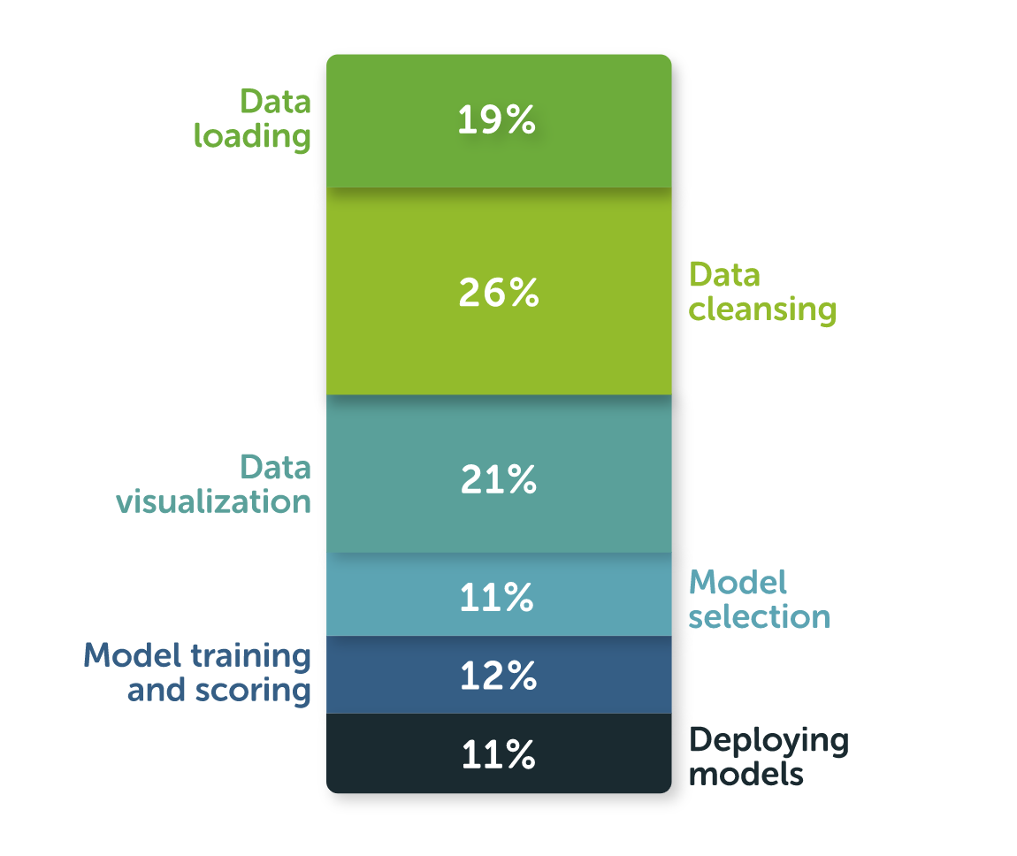
Motivation
In this data-driven-age, every small and large organization is taking their business decisions based on the data insights.
Transformation of raw data into usable cleaned data is crucial to take data-driven-decisions.
But Data preparation is challenging for multiple reasons
Data from different sources come in various sizes and are different in nature.
Lack of integration between different data sources across the organization
Lack of proper integration between different technologies used for data science
Different platforms, software, libraries, and databases are used by developers
Managing dependencies and environments is another hurdle
Developing ad-hoc codes for specific use case
Bulk time is spent on data preparation (According to Anaconda survey-2020,
on average 45% of time is spent on data preparation, 21% of time spent on visualization)
Data cleaning and preparation takes valuable time away from real data science work – model building and deployment
According to Anaconda’s survey, 47% of data scientists always use Python.
[The State of Data Science 2020]
DataMidWare is a data middleware which accelerates data preparation, analysis, and visualization tasks by integrating different technologies, software, and libraries using its APIs implemented in Python 3.

Slide 4
Introduction of DataMidWare
DataMidWare - A data middleware implemented in Python 3.7.
Provides direct interactions with database, data preparation & processing tool, algorithm library, and data visualization tool using its APIs.
Imports and parses raw data (csv, json, txt, xml) from different sources and load to database (MySQL, NoSQL).
Produces clean data from raw format and stores into database for analysis
Performs SQL queries using its APIs
Performs data analysis on the data stored in database
Provides direct visualization of data stored in database
Exports data in different format (csv, json) from database.
Accelerates data Preparation, Processing, and Visualization time

Slide 5



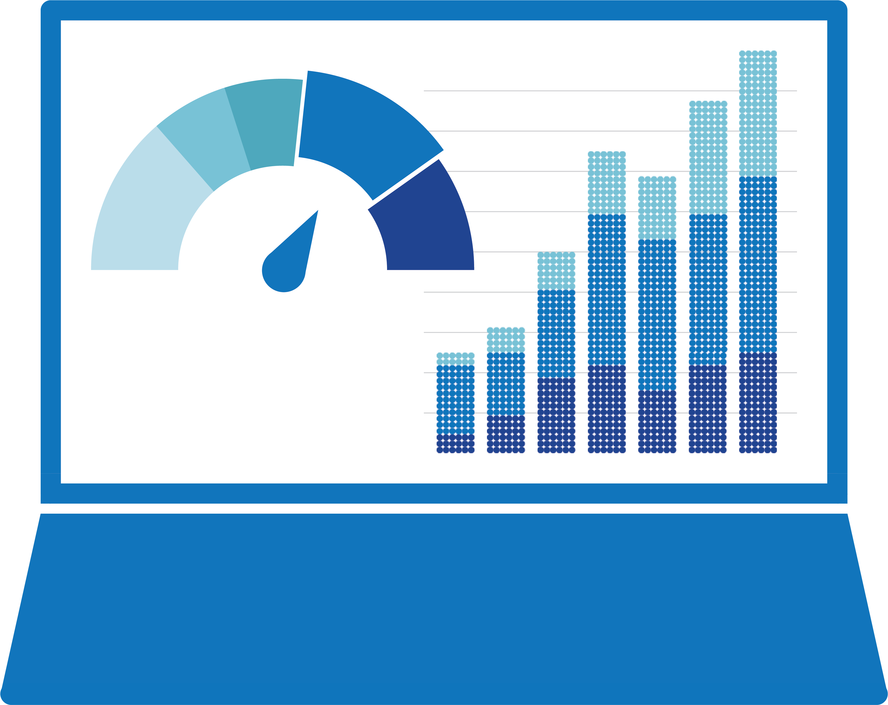








Architectural Overview
Application Layers
ETL
Query
Analytics
EDA
Models & Algorithms
Visualization
Python API Interface
Data Middleware
Data Processing Module - PyDp
Database Query Module - PyDb
Interface Module –
PyDm
Algorithms Module - PyAlgo
Data Visualization Module - PyViz
Database
File
Sources
Data Visualization
Static
Interactive
Dashboard
Web Visualization
MySQL
NoSQL
MSSQL

Slide 6
Development Process Overview
Requirements
Design
Implementation
Testing & Integration
Deployment
A Data Middleware that gives
flexibility to interact with databases, data process & analysis tools, algorithm library and visualization library
Create the architecture of the software system and its components
Implement the software
using Python 3
Implement Unit Test framework
In Python 3 and test the codes
Build Python package,
set up the environment and
run on Mac OS, Windows, & Linux system.

Slide 7
Code Architecture Representation using Component View
datamidware
__init__.py
pyalgo
pydb
pydm
pydp
pyviz
__init__.py
search.py
sort.py
__init__.py
create_connection.py
create_db.py
create_tb.py
mysql_query.py
__init__.py
file2db.py
db2file.py
db2viz.py
viz2db.py
db2algo.py
__init__.py
algorithm.py
__init__py
bar.py
setup.py
requirements.txt
LICENSE.txt
MANIFEST.in
README.md
tests
__init__.py
test_pydb.py
test_pydm.py
test_pydp.py
test_search.py
test_sort.py
test_mysql_query.py
settings

Slide 8
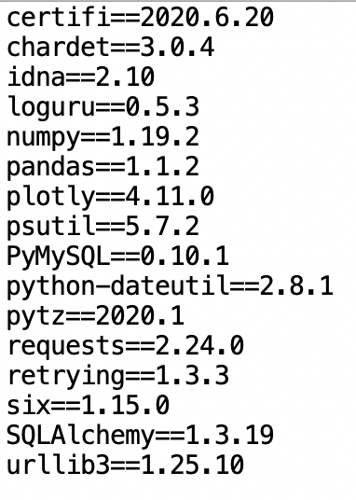
Software, Tools, Libraries
IDE: PyCharm 18.3
MySQL Workbench 6.3
Programming language: Python (version 3.7)
Python dependency packages
requirements.txt
Package | Version
Numpy | 1.19.2
Pandas | 1.1.2
Plotly | 4.11.0
PyMySQL | 0.10.1
requests | 2.24.0
SQLAlchemy | 1.3.19
urllib3 | 1.25.10

Slide 9
Code Implementation
API | Description | Parameters | Imports statement | Example Link
file2db.file2db(host, user, password, filename, db_name, tb_name, file_type="file_type", db_type="db_type") | Imports raw structured/semi-structured data (csv, json) into database (MySQL, NoSQL) | host: host name user: user name password: password filename: filename to send to database file_type: file type (csv, json), str db_type: database type (mysql, nosql), str tb_name: table name where data will be stored | from datamidware.pydm import file2db | Example
db2file.db2file(host, user, password, file_path, db_name, tb_name, file_type="file_type", db_type="db_type") | Exports table data as csv/json format from the database | host: host name user: user name password: password file_path: file path to export data from database file_type: file type (csv, json) db_type: database type (mysql, nosql) db_name: database from where data is exported tb_name: table from where data will be exported | from datamidware.pydm import db2file | Example
create_mysql_db.create_mysql_db(host, user, password, db_name) | Creates a new MySQL database | host: host name user: user name password: password db_name: database name to be created | from datamidware.pydm import create_mysql_db
mysql_query.MySQLDatabase.select(tb_name, row_count="all") | Execute SQL query: SELECT * FROM table. Selecting all(or one if row_count="one") rows from the table. | query: SQL query to select rows: SELECT * FROM <table> row_count: "all" or "one" row. default "all". return: list of rows selected. | from datamidware.pydm import mysql_query | Example

Slide 10
Code Implementation
API | Description | Parameters | Imports statement | Example Link
csv2mysql.csv2mysql(host, user, password, filename, db_name, tb_name) | Imports csv file into mysql database | host: host name user: user name password: password filename: filename to send to database db_name: name of the database -- if database already exists, import data in the existing database, if not exists, create new database and import data. tb_name: name of the table - if table already exists, add data in the existing table, if not exists, create new table and import data. | from datamidware.pydm import csv2mysql
mysql2csv.mysql2csv(host, user, password, file_path, db_name, tb_name) | Exports csv file from mysql database table | host: host name user: user name password: password file_path: file path to save csv file db_name: name of the database from where data will be exported tb_name: name of the table from where data will be exported | from datamidware.pydm import mysql2csv
db2viz.db2viz(host, user, password, db_name, tb_name, kind=None, x=None, y=None, …) | Visualize the Database table data | host: host name, user: user name password: password, db_name: database name tb_name: table name, kind: plot kind (bar, horizontal bar, hist,..), file_path: file path to save figure x: x data; list or array-like, y: y data; list or array-like title: title of the figure, label: x-label, y-label | from datamidware.pydm import db2viz | Example

Slide 11
Testing
To test all the modules, run all the above unittest command from the top-level directory
To successfully run the test, config.ini file is required
To write confitg.ini file go to /settings
update write_config.py with database connection credentials, for e.g., (for MySQL database connection) config_object["MYSQL"] = { "host": "hostname", "user": "username", "password": "password" }
Modules | Description | Execution command | Remark
test_pydm.py | Test module for pydm sub-package | python3 -m unittest tests/test_pydm.py | Pass
test_mysql_query.py | Test module for mysql_query.py module | python3 -m unittest tests/test_mysql_query.py | Pass
test_search.py | Test module for search.py module | python3 -m unittest tests/test_search.py | Pass
test_sort.py | Test module for sort.py module | python3 -m unittest tests/test_sort.py | Pass

Slide 12
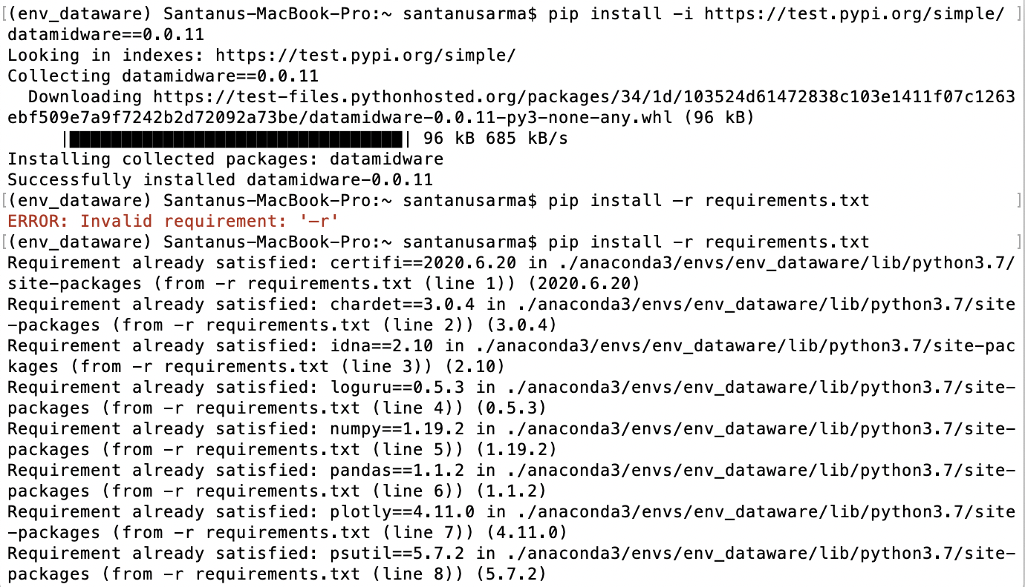
Deployment & Execution
Using the terminal or an Anaconda Prompt, create a new environment –
Activate new environment using -
Install package using pip –
Install requirements.txt using pip -
conda create –n env_name python=3.7
conda activate env_name
pip install -i https://test.pypi.org/simple/ datamidware==0.0.11
pip install –r requirements.txt

Slide 13
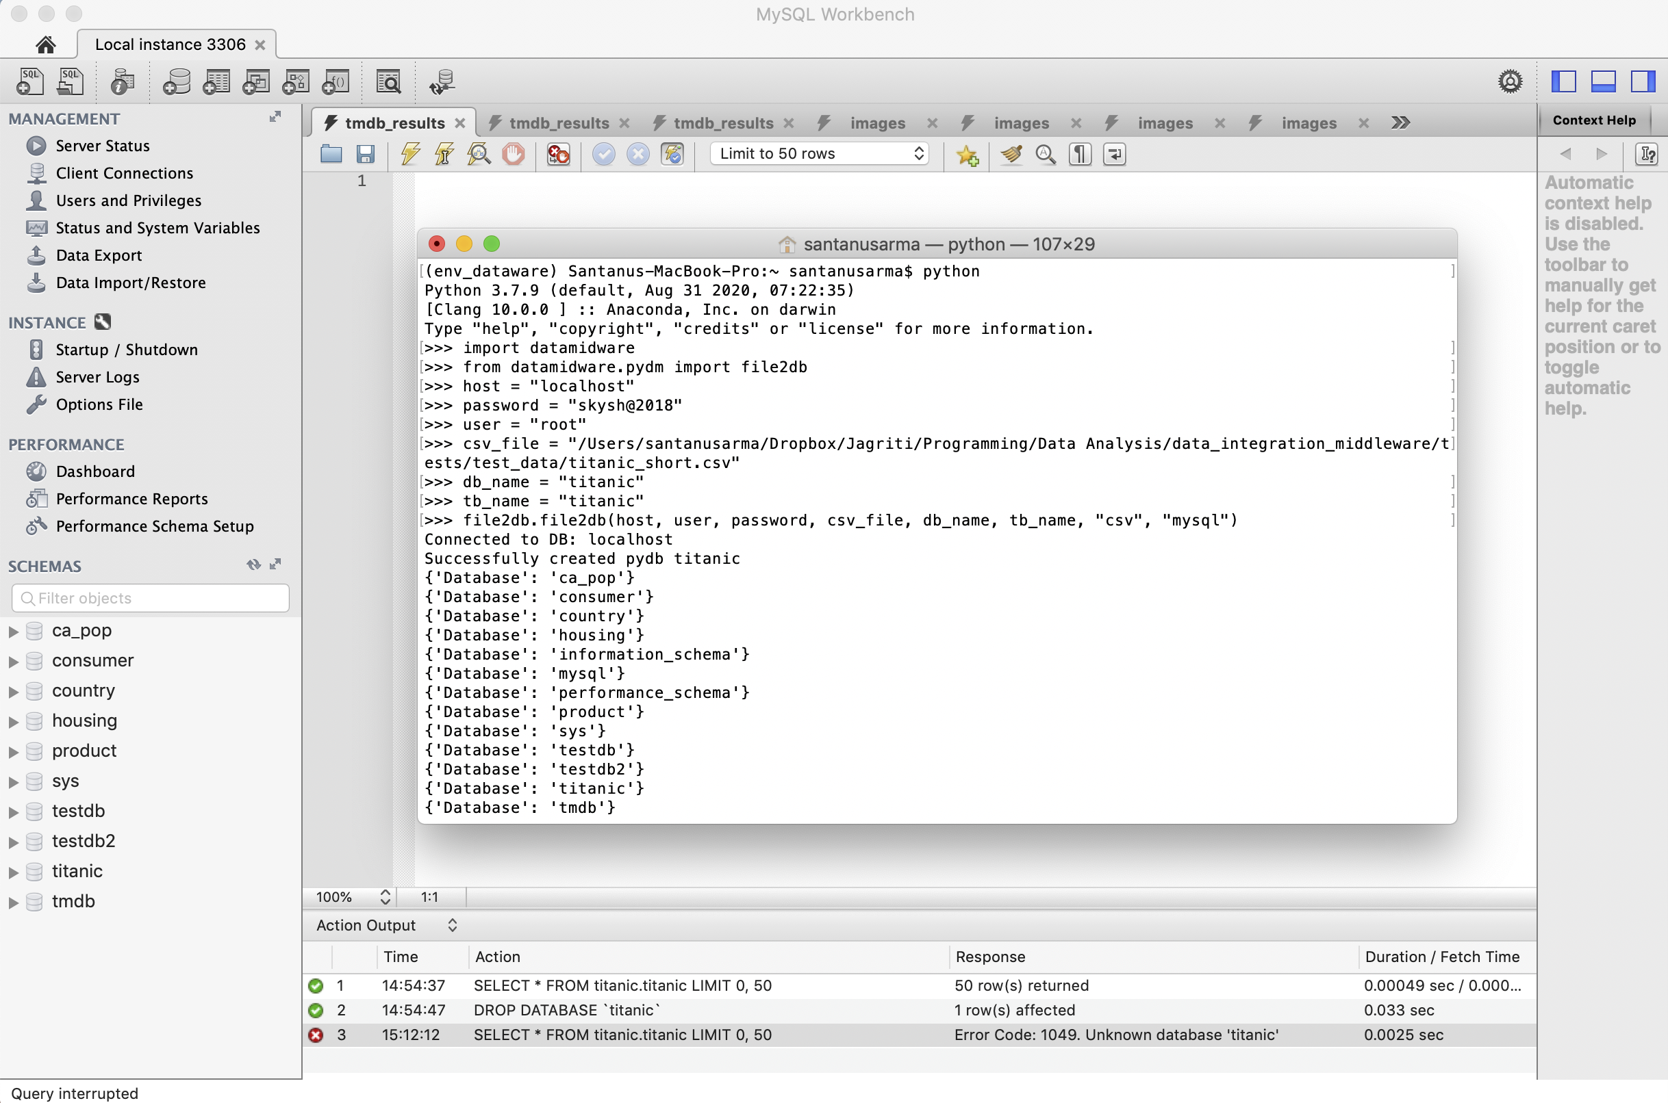
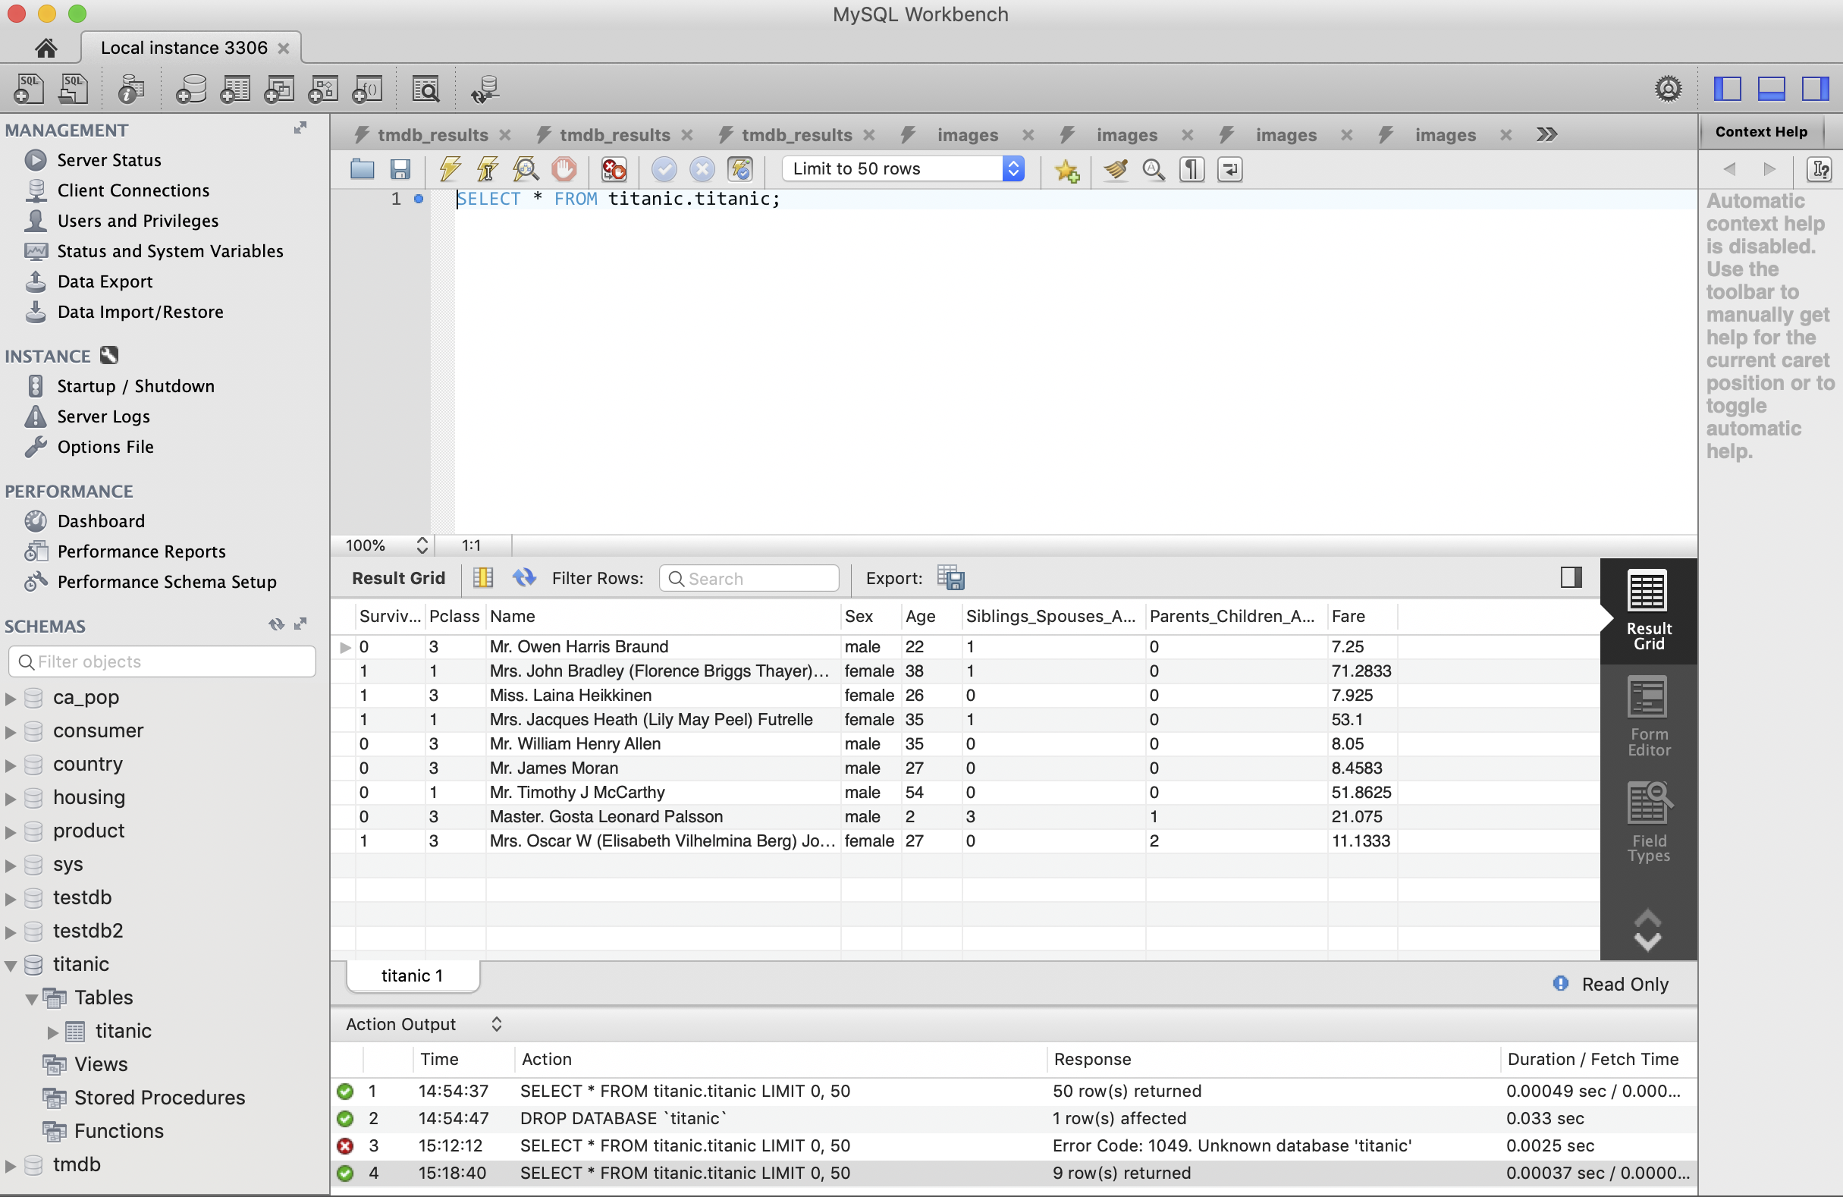
Example:file2db.file2db(host, user, password, filename, db_name, tb_name, file_type="file_type", db_type="db_type")
Execute file2db.file2db(host, user, password, filename, db_name, tb_name, file_type="file_type", db_type="db_type") to load csv file into MySQL DB
Example data: titanic.csv
Back

Slide 14
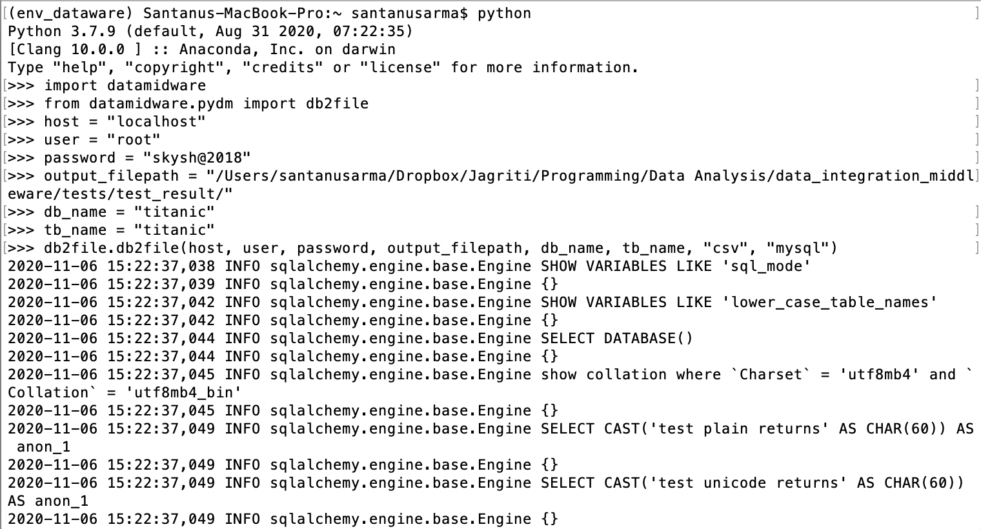
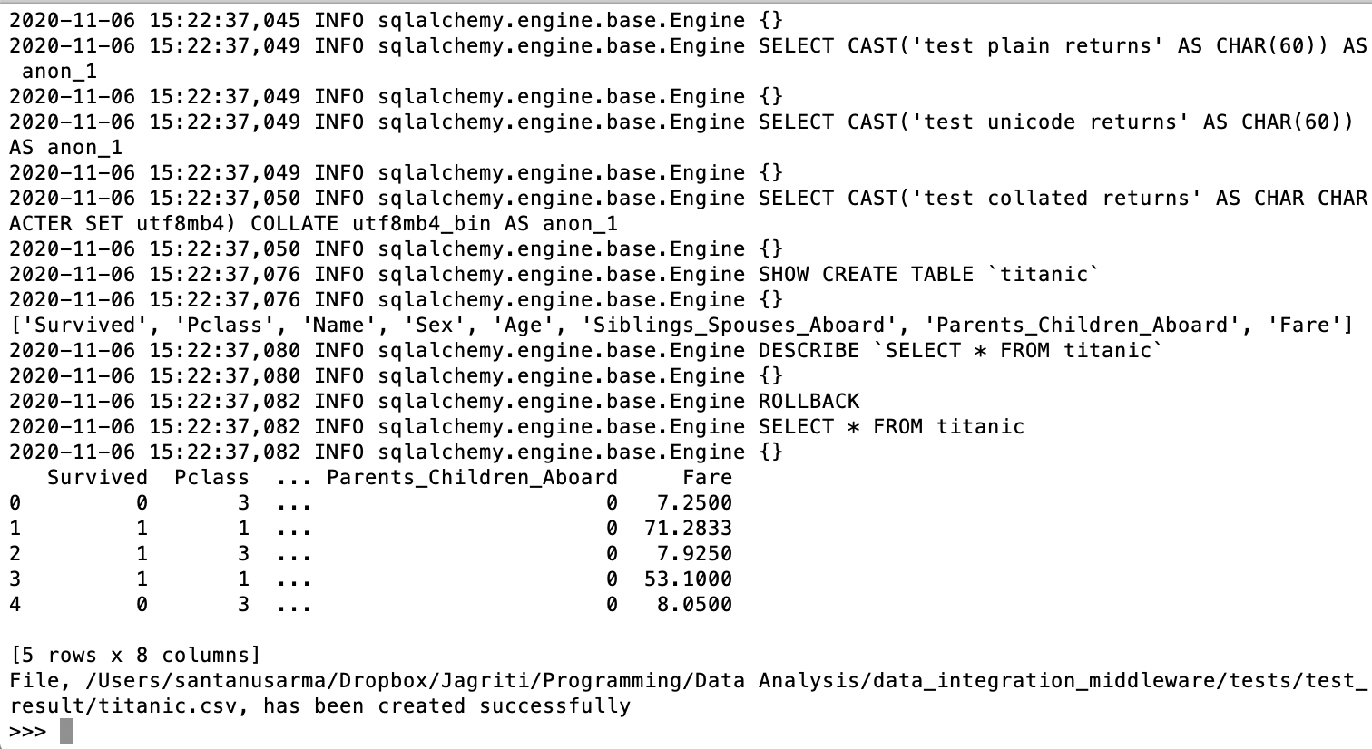
Example:db2file.db2file(host, user, password, file_path, db_name, tb_name, file_type="file_type", db_type="db_type”)
Execute db2file.db2file(host, user, password, file_path, db_name, tb_name, file_type="file_type", db_type="db_type”) to export csv file from MySQL
Example data: MySQL database name : titanic, table name = titanic
Back

Slide 15
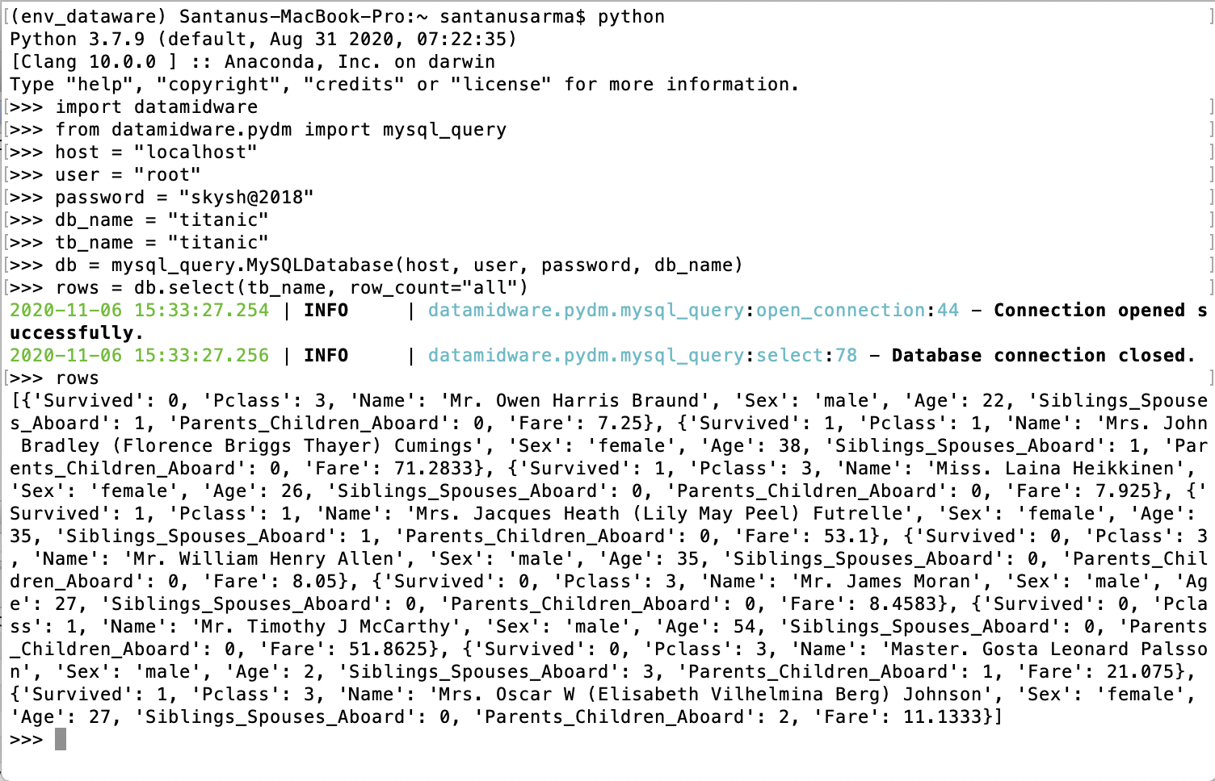
Example: mysql_query.MySQLDatabase.select(tb_name, row_count="all”)
Execute mysql_query.MySQLDatabase.select(tb_name, row_count="all”) to select all rows from MySQL table
Example data: MySQL database name : titanic, table name = titanic
Back

Slide 16
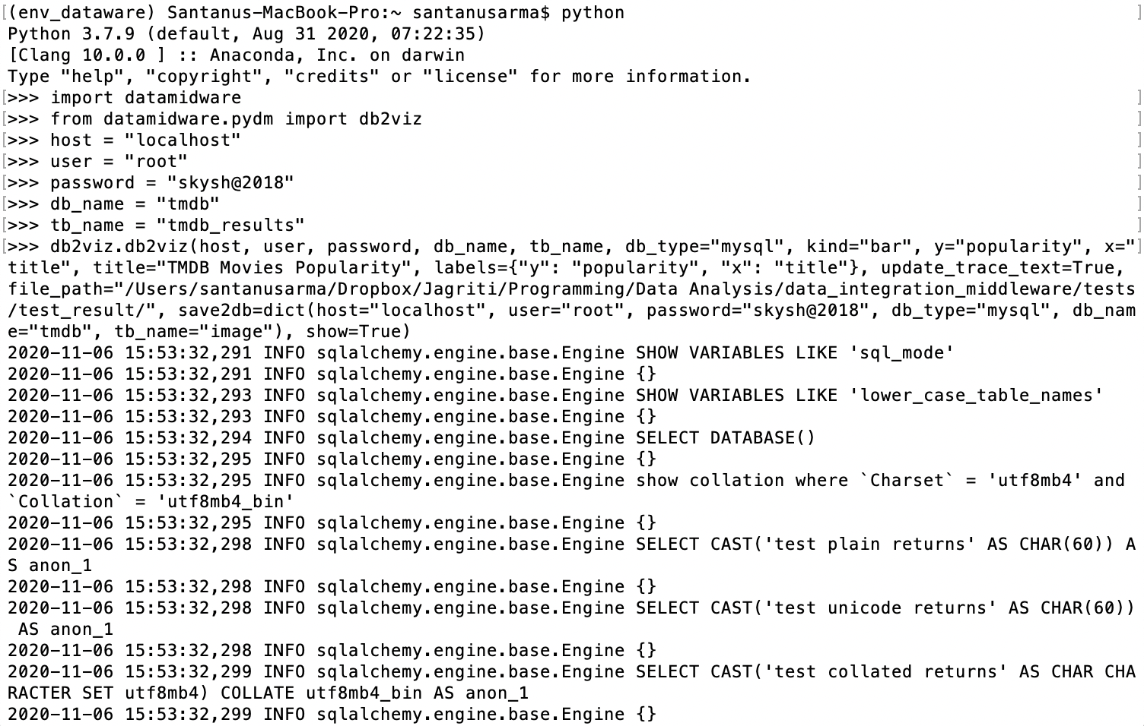
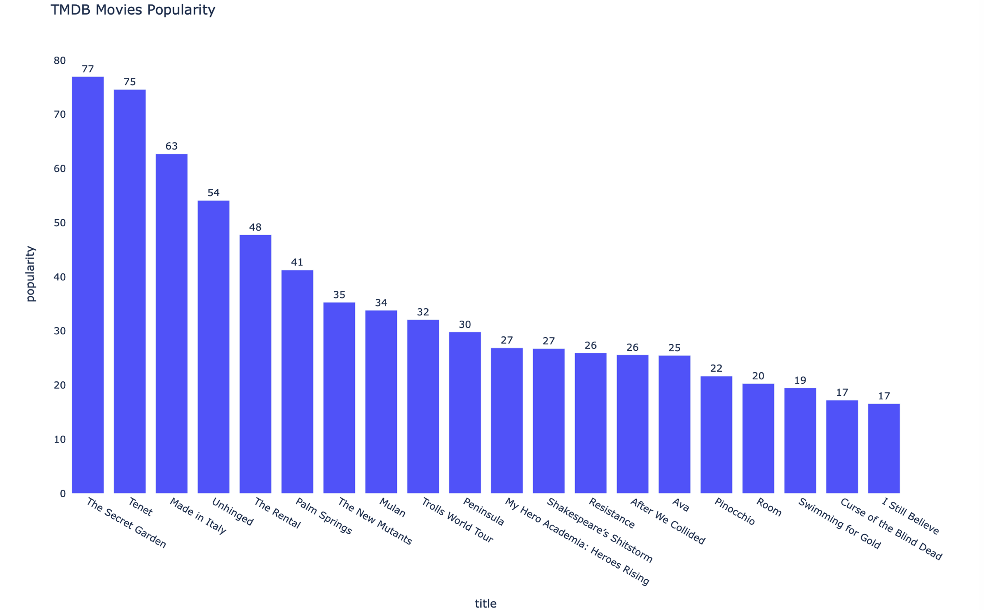
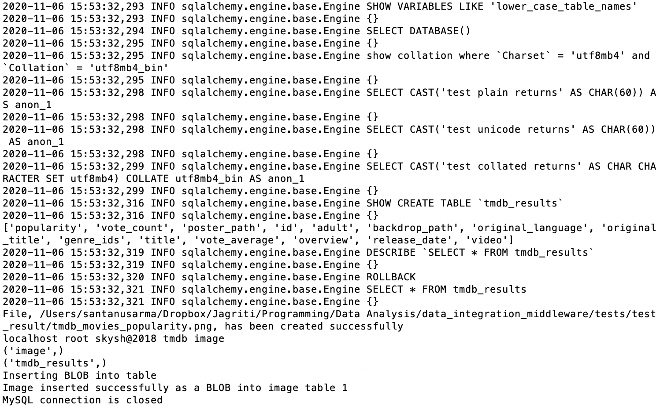
Example: db2viz.db2viz(host, user, password, db_name, tb_name, kind=None, x=None, y=None, …)
Execute db2viz.db2viz(host, user, password, db_name, tb_name, kind=None, x=None, y=None, …) to plot bar chart to visualize movies by popularity from tmdb_results table from MySQL database tmdb.
Example data: database name - tmdb, table name - tmdb_results
Back

Slide 17
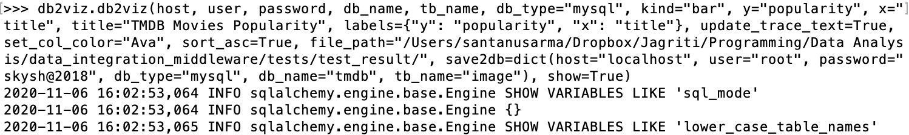
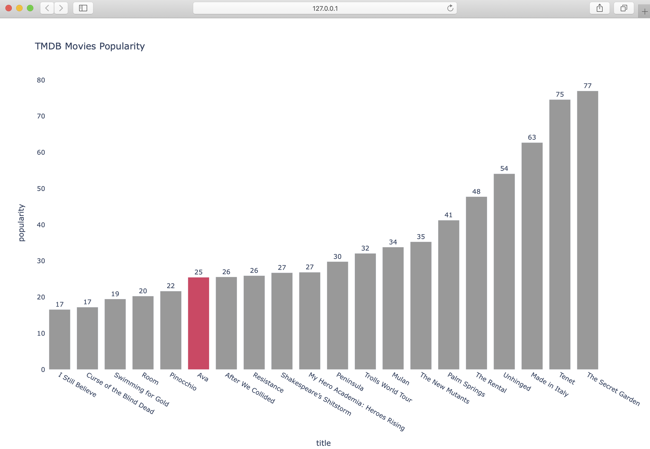
Example: db2viz.db2viz(host, user, password, db_name, tb_name, kind=None, x=None, y=None, …)
Execute db2viz.db2viz(host, user, password, db_name, tb_name, kind=None, x=None, y=None, …) to plot bar chart for movies by popularity from tmdb_results table in ascending order and highlighting movie title - “Ava”
Back

Slide 18
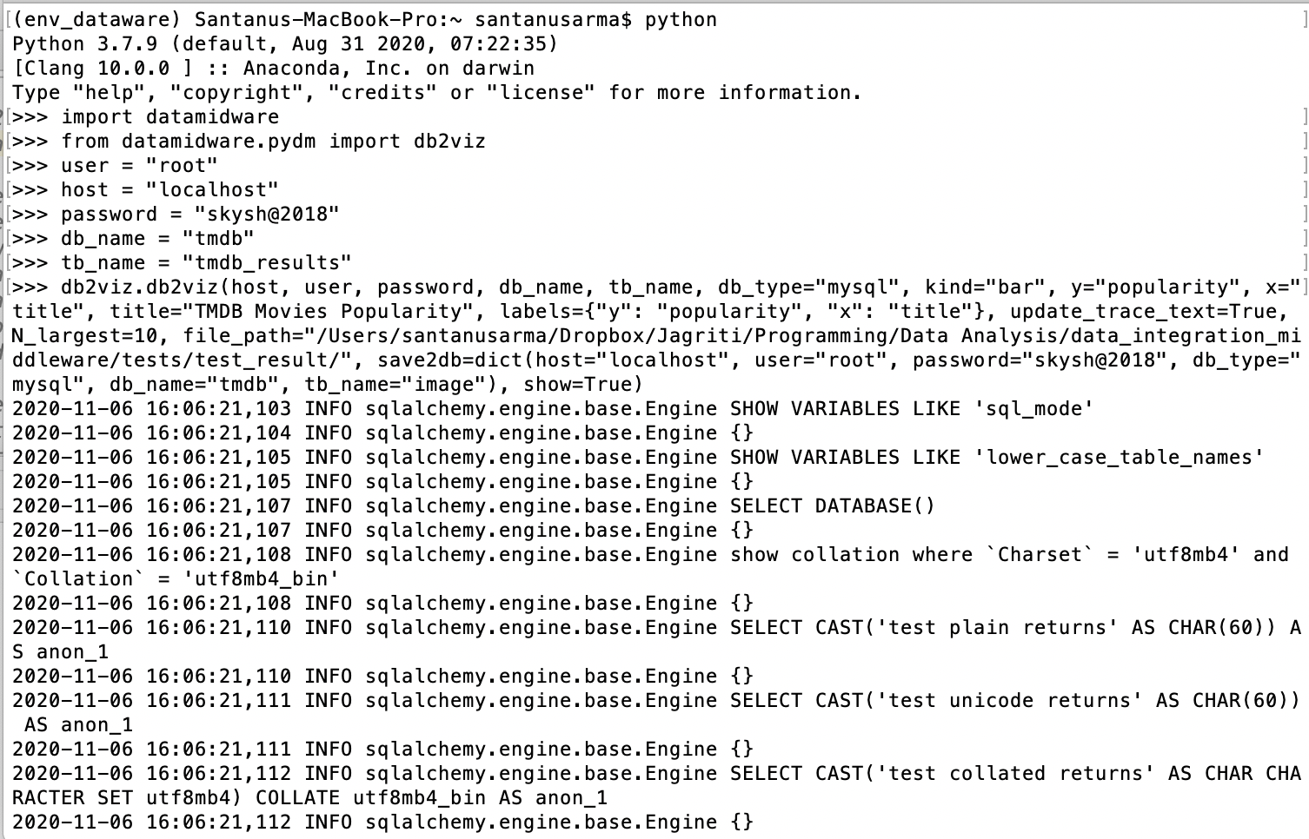
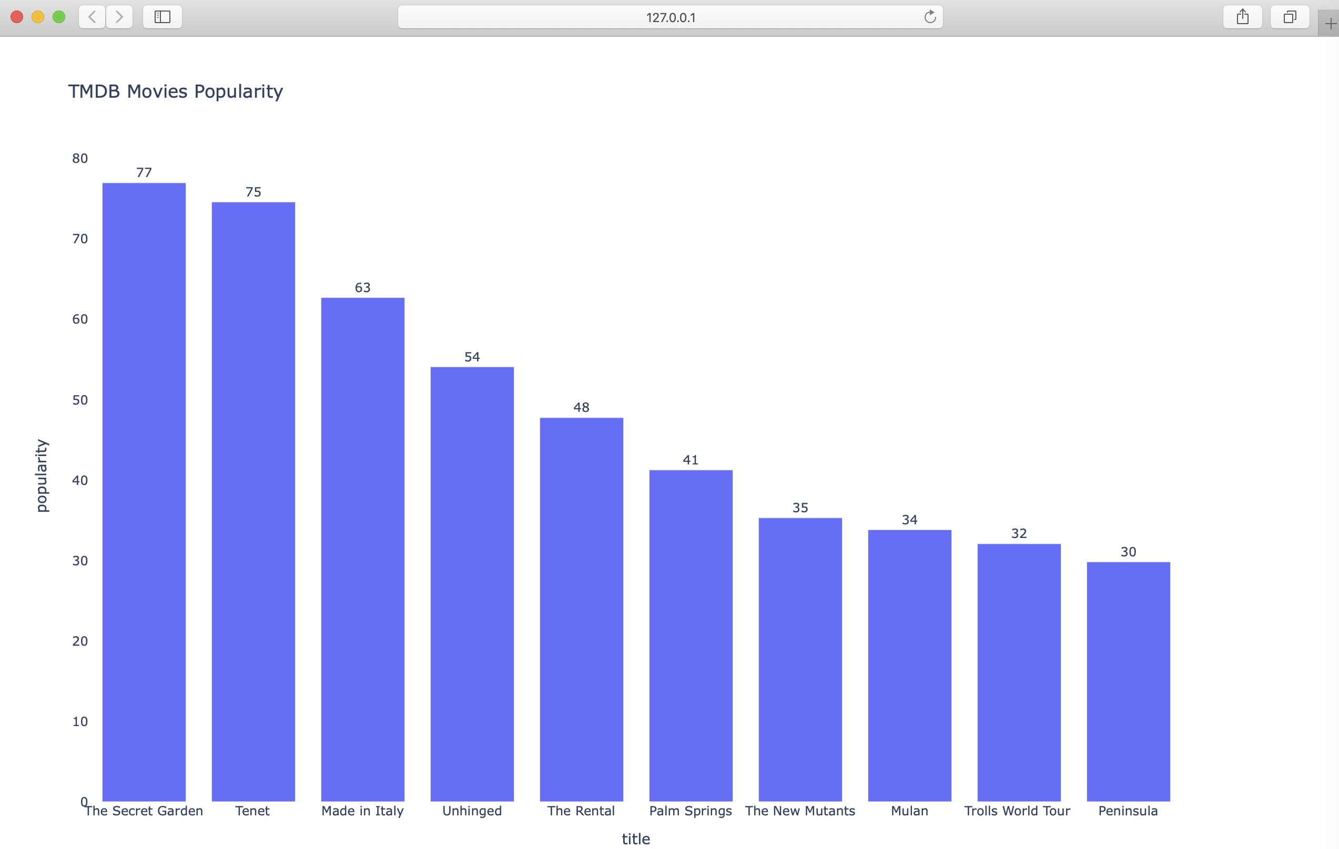
Example: db2viz.db2viz(host, user, password, db_name, tb_name, kind=None, x=None, y=None, …)
Execute db2viz.db2viz(host, user, password, db_name, tb_name, kind=None, x=None, y=None, …) to plot bar chart for 10 highest movies by popularity from tmdb_results table of tmdb database.
Back

Slide 19
Summary & Future Work
Summary
A data middleware that gives flexibility to directly interact with database, data preparation & processing tool, algorithm library, and data visualization tool using its APIs; accelerates data preparation, processing, & Visualization time
Imports and parses raw data (csv, json, txt, xml) and load to database (MySQL, NoSQL).
Produces clean data from raw format and stores into database for analysis
Performs SQL queries
Provides data analysis and direct visualization of data stored in database
Exports data in different format (csv, json) from database.
Future Work
Extend all the libraries – (data processing, algorithms, and data visualization library)
Integrate Exploratory and Inferential data analysis library
Integrate Machine Learning algorithms library
Integrate Web Visualization
Integrate with other Databases (MSSQL)
Integrate with Splunk

